Slide 1
The chemicals of life
Chapter 4

Slide 2
Polymers and macromolecules
Biological molecules are typically large molecules constructed from smaller subunits.
Monomer: single subunit
(mono = 1; -mer = unit)
Di and bi : two units
Polymer: many units – many repeating subunits
(poly = many)

Slide 3
Elements that make up 95% of living organisms (by weight)
C Carbon
H Hydrogen
O Oxygen
N Nitrogen
S Sulfur
P Phosphorus

Slide 4
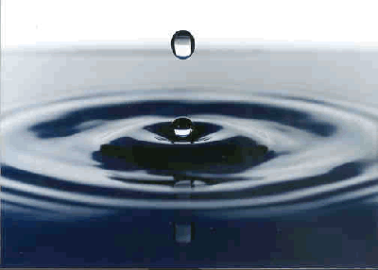
Water
About 70-95 percent of the mass of the cell is water , 60 % of ur body and three quarters of the planet
It provides an environment for those organisms that live in water
Water is used in most reactions in the body
Water is called the universal solvent

Slide 5
Water
80% of the body is made up of water.
Cytoplasm of the cell mainly water.
The spaces between cells are also filled by a watery liquid.
Metabolic reactions can only take place if the substances dissolved in water- water is an important solvent.
Plasma of the blood ,contains a lot of water and substances dissolve in it such as glucose ,enzymes and nutrients .
Water help us to get rid of waste products such as urea .
Note : do not use – to do not dry out of organism .

Slide 6
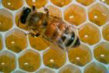
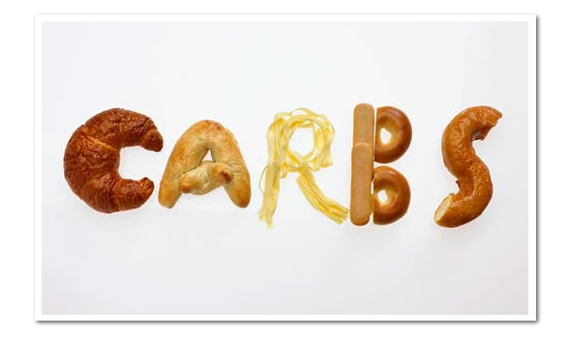
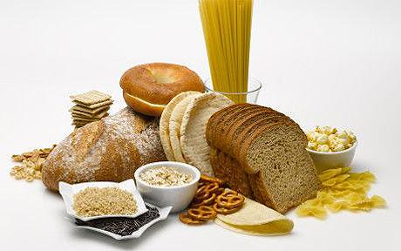
Carbohydrates
Contains : C,H,O
Has about twice as many H to C or O

Slide 7
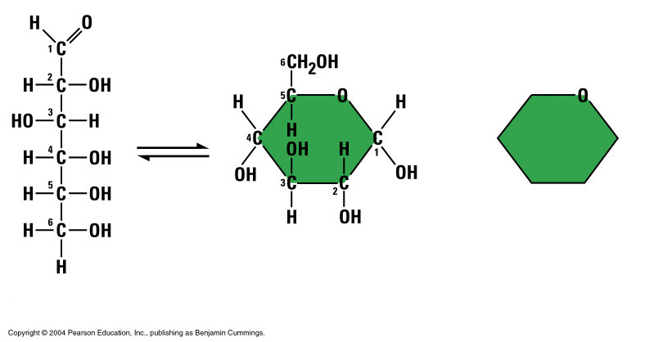
Simple sugar or Monosaccharide's - are sugars with -6- carbon atoms joined in a ring OH and H groups pointing out from ring . - Taste sweet - Very small - Soluble in water Ex. : glucose . or

Slide 8
Carbohydrates
Disaccharides contain two monosaccharaides
Ex . Sucrose , maltose .
Soluble in water
Taste sweet

Slide 9

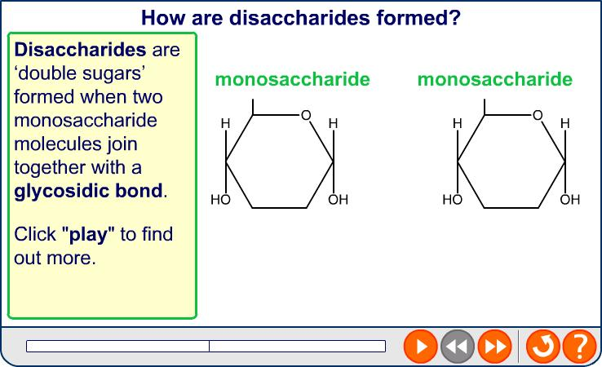

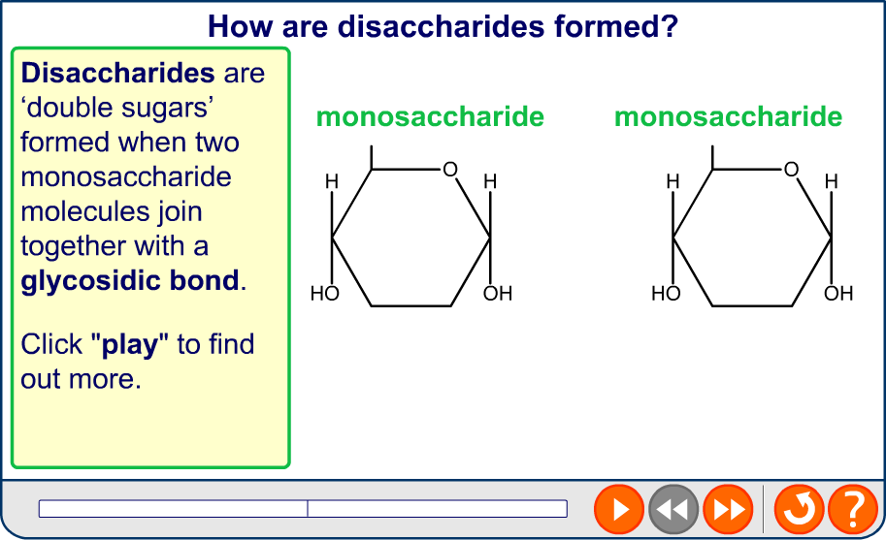
The formation of disaccharides

Slide 10
Carbohydrates
Polysaccharides are long polymers that contain many glucose subunits.
Thousands of sugars.
Insoluble in water.
Do not taste sweet.
Ex. Cellulose, starch ….. In plants only
glycogen ……………In animals only

Slide 11
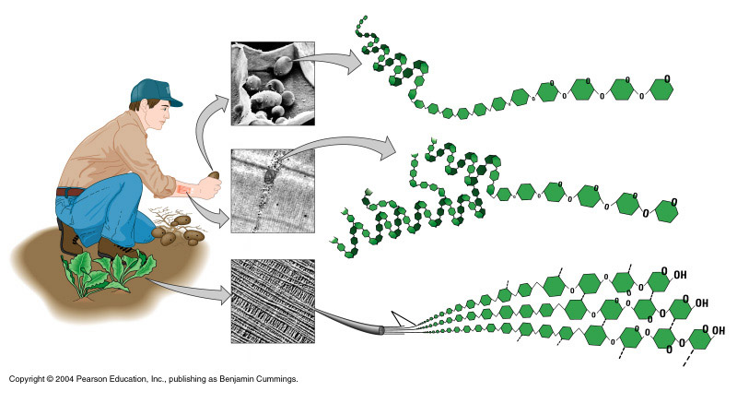
Examples of Polysaccharides
Glucose Monomer
Starch
Glycogen
Cellulose

Slide 12
Carbohydrates
Some Functions:
needed for energy production– 1g give 17 KJ … mainly Glucose needed to make respiration for energy production.
.
plants store carbohydrates as starch.
It is easy to change glucose into starch and starch to glucose . So plants store large quantities of starch in their seeds or tubers.
Animals do not store starch . Instead , they store glycogen . Small quantities can be stored . Mostly in liver and muscles .
Cellulose is used to make the criss -crossing fibres / it is very strong molecule form cell wall of plants that is used to maintain the shape of the plant cell.

Slide 13

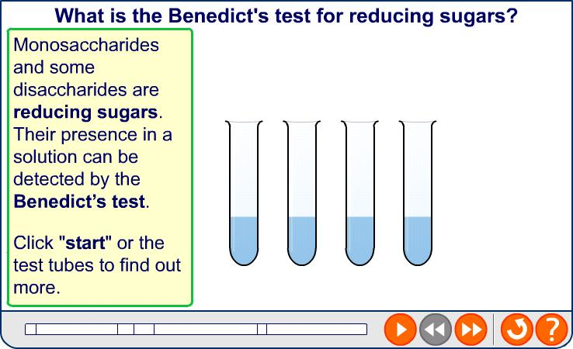
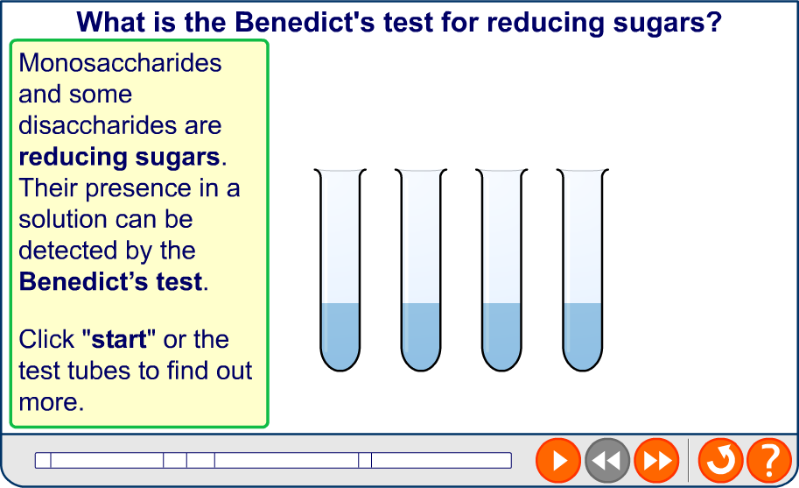
Benedict’s test for reducing sugars

Slide 14
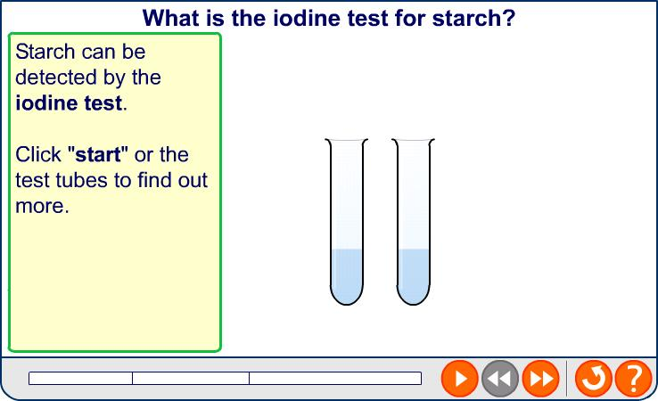

Iodine test for starch

Slide 15
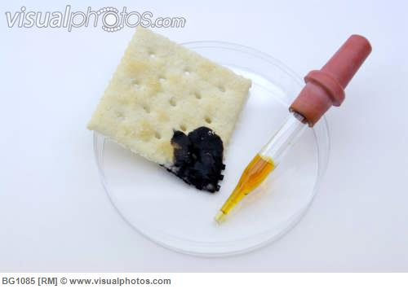
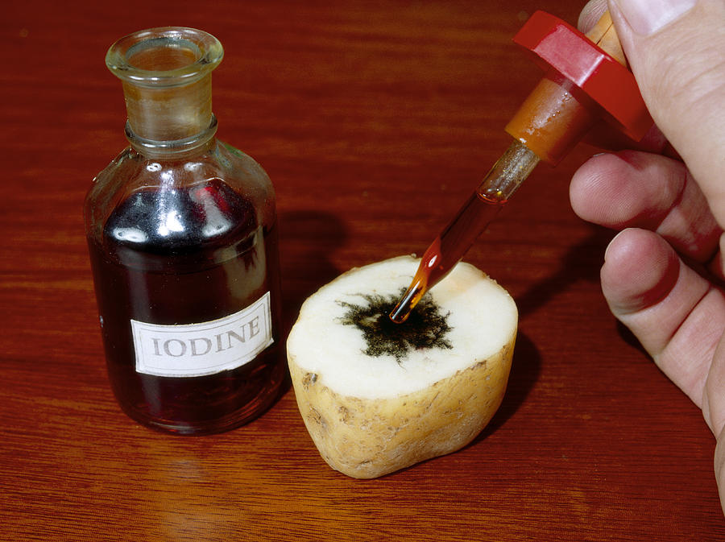
Test for starch
Orange –brown blue – black color

Slide 16
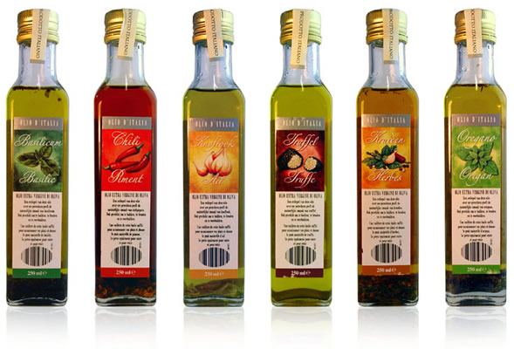
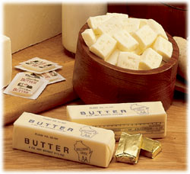
Fat or Lipids
Contains : C,H,O
Has 3 fatty acid and one glycerol
Insoluble in water .
Fats that are liquid at room temperature are called oil .

Slide 17
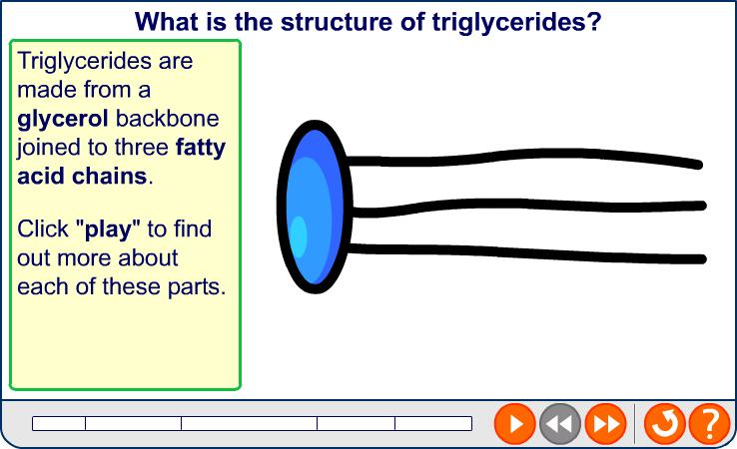

The structure of triglycerides

Slide 18
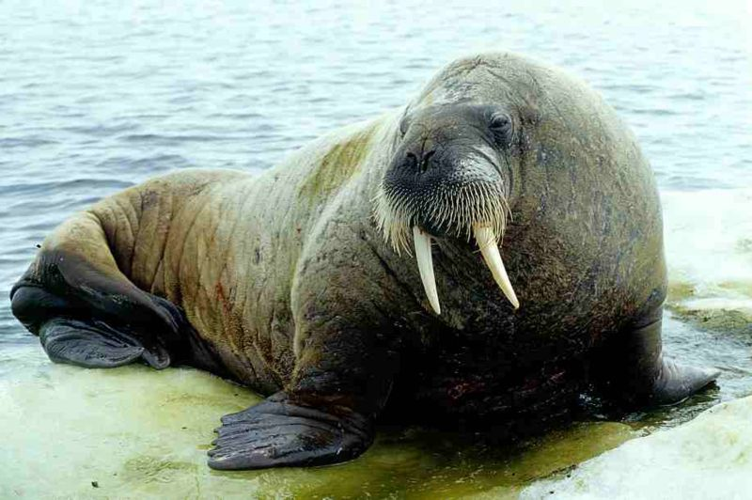
Lipids
Some Functions:
release energy 1g give 39 KJ , 2X than carbs
Carbs used first to produce energy , and only use fat when all the available carbs have been used .
Useful for storing energy. In mammals , some cells specially ones underneath the skin , became filled with large drops of fats or oils used later to release energy when needed , these cells called adipose tissue or blubber .
Adipose tissue insulates the body , walruses
Oils a good store of energy
In germination so plants store oil
In their seeds : peanut , coconut
Castor oil .
Protection of major organs.

Slide 19
Fats and Oils
Fats
Usually of animal origin
Solid at room temperature
Oils
Usually of plant origin
Liquid at room temperature

Slide 20
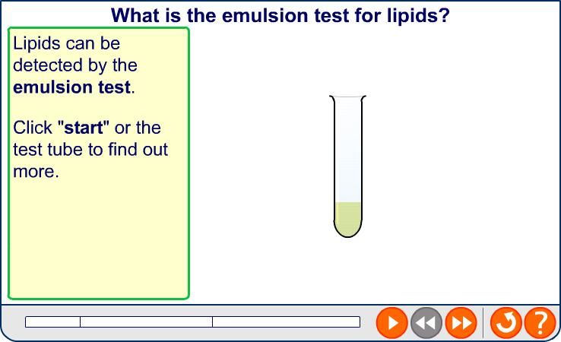

Emulsion test for lipids

Slide 21
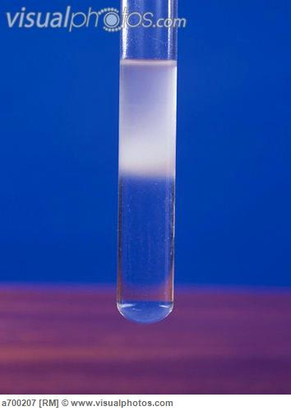
Emulsion Test For Lipids Testing for the presence of lipid
White and opaque like milk , if there is no fat the mixture remains transparent

Slide 22
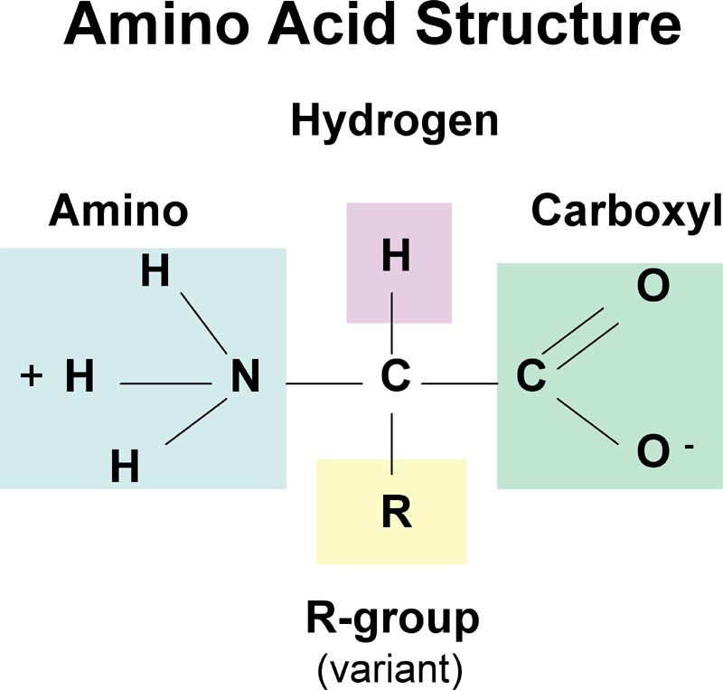
Proteins
Contains : C,H,O, N, S
Proteins are comprised of amino acids in precise order , any small difference makes different protein .
20 amino acid

Slide 23

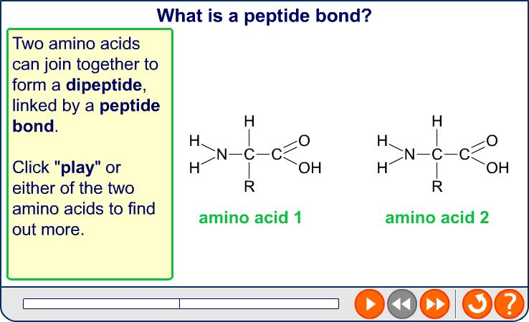
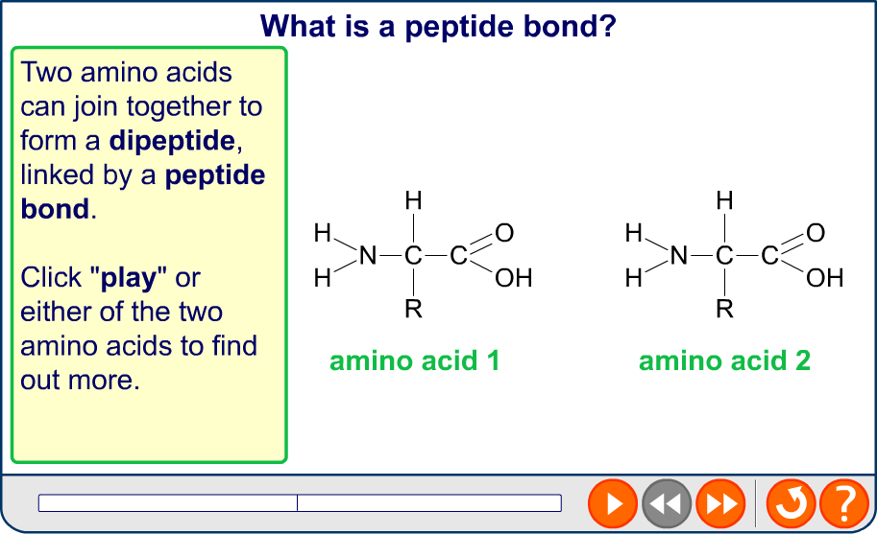
Peptide bonds and dipeptides
Notes:
Teacher notes
Condensation reaction and hydrolysis reaction of dipeptides is just the same as for disaccharides, but a peptide bond is formed rather than a glycosidic bond.

Slide 24
Proteins
polypeptide is a single chain of amino acids
Protein : more than one chain joined together to form protein , also each chain formed from amino acids .
Note : we have high concentration of protein inside cell membrane and cytoplasm.

Slide 25
Proteins
Proteins have important functions in cells.
Proteins such as keratin have structural roles in hair and fingernails, it is insoluble in water .
Proteins are also enzymes that speed up the chemical reactions of metabolism, soluble in water .
Proteins such as hemoglobin are responsible for the transport of substances : O2 –CO2 . This protein soluble in water .
It is not normally used to provide energy .
Needed to make new cells , repairing damaged parts of the body.

Slide 26
Proteins
Proteins form the antibodies of the immune system that defend the body from disease.
Proteins such as insulin are hormones.
Contractile proteins such as actin and myosin allow parts of cells to move and muscles to contract.

Slide 27
Three – dimension shape of protein
Protein curl up to form the final shape.
The shape of enzyme for instants determined which reaction can catalyze.
The shapes of antibody molecules are needed to bind to different kinds of bacteria and viruses.

Slide 28
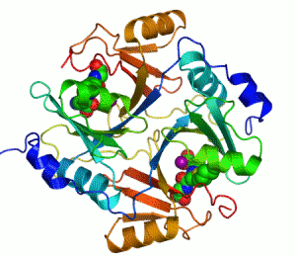
Lysozyme enzyme : found in tears and saliva .

Slide 29
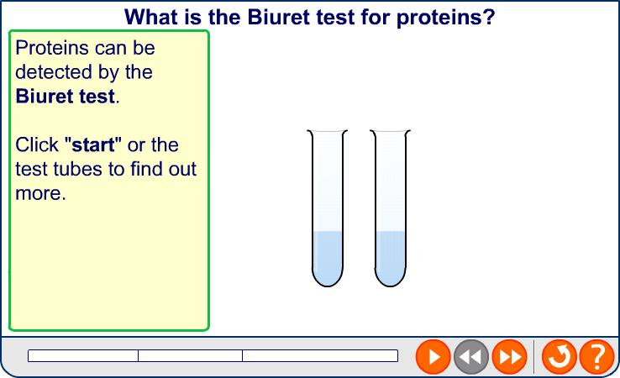

Biuret test for proteins

Slide 30
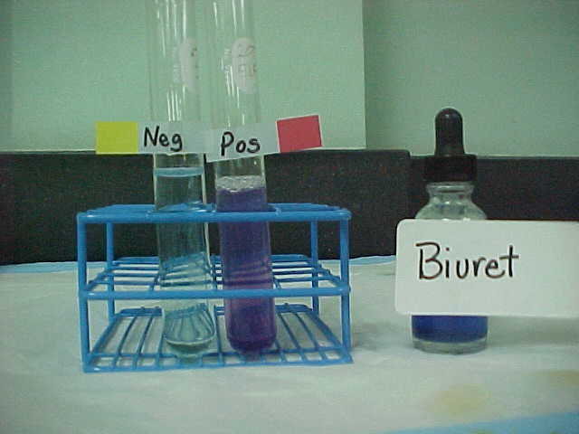
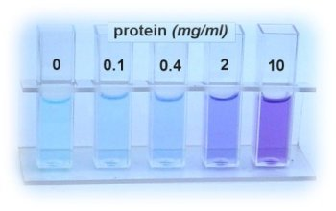
Biuret Test For Protein

Slide 31
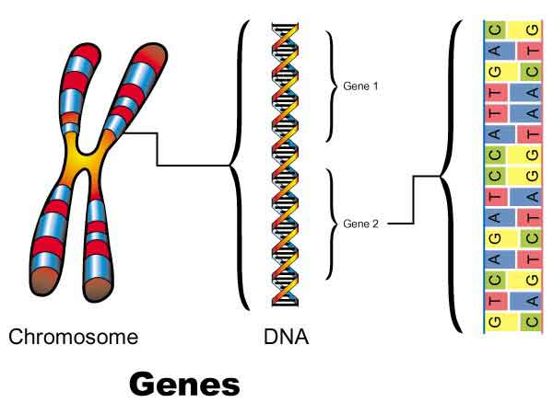
Nucleic Acids
DNA (deoxyribonucleic acid)

Slide 32
Nucleic Acids
DNA (deoxyribonucleic acid)
RNA (ribonucleic acid)

Slide 33
Nucleic Acids
DNA stores genetic information. That we inherit from our parents.
DNA codes for the order of amino acids in a protein, determines personal characteristics such as your hair color , your blood group …. Etc ..

Slide 34
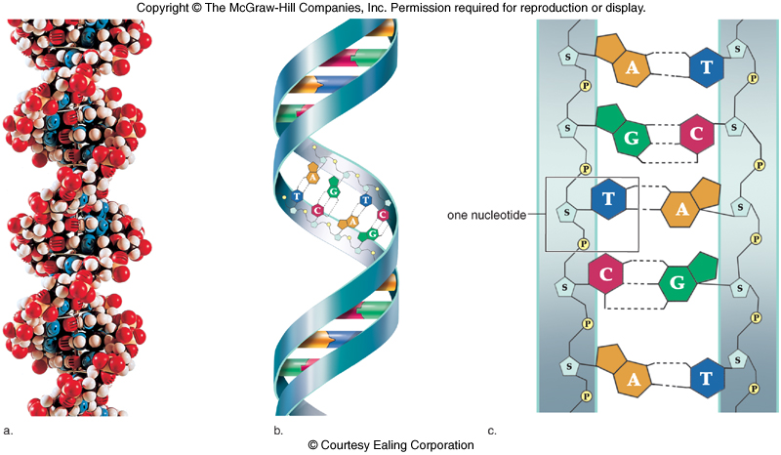
Nucleic Acids
The 2 strands held together by bonds
DNA Structure
Twist together into a helix

Slide 35
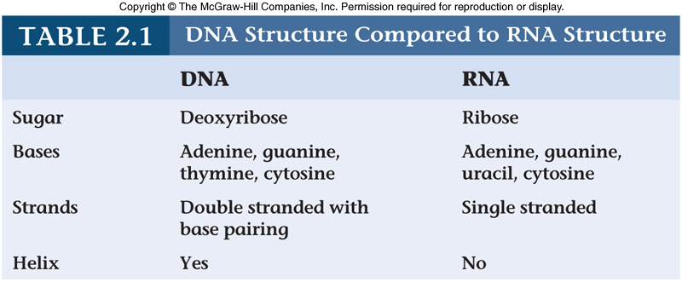
Nucleic Acids
A , G,C,T
A , G,C,U

